Slide 1
An entire term of live daily Moodle backups.
On a budget.

Slide 2
Hardware
Desktop PC Hardware
I7-4700@3.4GHz, 16GB RAM
Z87 Motherboard w/ 10 SATA III ports
15 - 3TB HDD (Don’t use WD Green drives, unless you disable power saving)
650W Power Supply 80+ Bronze (Minimum ~200W + 10W/HDD)
PCIe x2 SATA III 8 port
Server Case (4U)
15 3.5” HDD slots.

Slide 3
Software
Ubuntu Server (16.04 LTS)
1 HDD is the system drive.
Software based RAID 6 using MDADM.
3TB * (14 drives - 2 parity drives - 1 hot spare drive) = ~33TB of storage
Formatted in ext4.
PostgreSQL (9.4)
Multiprocess parallel backup and restore using “Directory output format”
Apache2
PHP 7.0
Mbackup scripts
https://github.com/SWiT/moodle-backup_scripts

Slide 4
We have 3 separate Moodle services.
moodle.oakland.edu - The main LMS site for all University courses.
espace.oakland.edu - Resource for University Organizations and Departments.
portfolio.oakland.edu - “Publicly” accessible student portfolios.
Our “Moodle” service instance is the biggest with a ~140GB DB and ~3.5TB of files.
On our production (replicant) Postgres DB server we run a database backup process every night that creates a folder containing “Directory output format” (*.data.gz) files (<10 minutes, ~140GB -> ~14GB)
At the same time the DB backup begins. We run backupFiles.php. It copies all the files in the Moodle instance to a temporary folder on the MBackup server. It also creates a new folder with the version of the Moodle PHP code that was running that day.
After the DB backup completes we run backupDB.php. It transfers the DB backup folder to the MBackup server and restores it.

Slide 5
backupFiles.php
Rsync the production (replicant) file repository to a temporary local folder (moodletmp).
Create a moodlebackup.log file containing the total size of that days file repository.
Delete file repositories that are too old and out of the configured date range.
“cp -alf” hardlinks from the temporary local folder (moodletmp) to moodledata[DATESTAMP]
“rsync -aH --delete” from moodletmp to moodledata[DATESTAMP] to remove deleted files.
Delete out of range Git repositories
Create new instance of the git repo moodle[DATESTAMP]. Get the current commit hash from a production front end and checkout the same commit. Log the commit hash
Generate the config.php file for that days Moodle instance.
backupDB.php
Remove old out of range moodle[DATESTAMP] DB archive files.
Download todays backup directory from the Production DB Replicant and rename it to moodle[DATESTAMP].
Drop old out of range databases from the DB.
Create a new moodle[DATESTAMP] DB.
Extract the new moodle[DATESTAMP] backup directory to the new moodle[DATESTAMP] DB. “pg_restore -j 7” (use the number of cores -1)
Purge All Caches.

Slide 6
Moodle’s Config.php (Prod vs. MBackup)
$CFG->auth = ''; // Disables LDAP and CAS authentication.
$CFG->noemailever = true;
$CFG->sessioncookie='[SERVICE][DATESTAMP]';
$CFG->debugusers = '[DEBUG_USERS]';
$CFG->pathtounoconv = '/usr/bin/unoconv';
config.template.php is the template for Moodle’s config.php with place holders to insert values from moodlebackup.config.php and [SERVICE]/config.inc.php

Slide 7
MBackup config file
Moodlebackup.config.php
DB username
DB password
File storage root
HTML root
List of SERVICES.

Slide 8
MBackup [SERVICE] config file
[SERVICE]/config.inc.php
SERVICE label (“moodle”, “espace”, “portfolio”, “rebranded-moodle”, etc.)
DATE_RANGE in the PHP DateInterval class notation (ex. “P30D” for 30 days)
FILEDATA_TEMP location to temporarily store file data while synchronizing between the MBackup and production servers.
FILEDATA_ROOT the root folder to store [SERVICE]data[DATESTAMP] folders in.
DB_ARCHIVE the local folder to keep the compressed DB backup files in.
GIT_REPO the link to the git repo for the service.
PROD_SERVER the address for the DB and file data server
PROD_DB_ARCHIVE the location of the DB backups on the production server.
PROD_FILEDATA the location of the file data directory on the production server.
PROD_FRONTEND the address of the front end server that runs the Moodle PHP code.
DEBUG_USERS a comma separated list of admin users to see debug messages.

Slide 9
Additional scripts
check_raid.sh checks the status of drives in the RAID array, and available free space. Sends an email if something isn’t right. Must be run as root.
regenerateConfig.php recreates the config.php file for a set of moodle instances. Useful for adding a new admin or manager.
purgecaches.sh purges ALL the caches on ALL the moodle instances.
index.php a simple front end that lists all the moodle services instances
moodlebackup.sql run this to create the “moodlebackup” database for keeping instances indefinitely.
nightlydump.pl example perl script that runs on prod server to backup the DB.

Slide 10
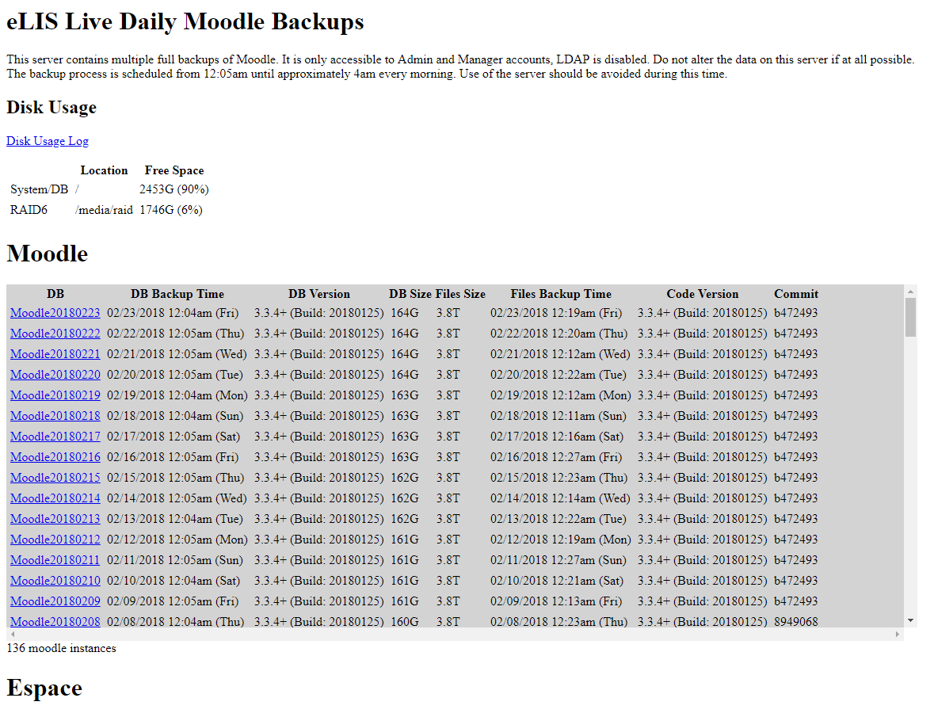

Slide 11
Cron
As root:
# m h dom mon dow command
0 */4 * * * /home/moodleadmin/moodlebackup_scripts/check_raid.sh > /home/moodleadmin/log/check_raid.log
As the admin or apacheuser account:
5 0 * * * /usr/bin/php /home/moodleadmin/moodlebackup_scripts/backupFiles.php -s moodle -y > /home/moodleadmin/log/moodle/`date +\%Y\%m\%d`_files.log 2>&1
5 1 * * * /usr/bin/php /home/moodleadmin/moodlebackup_scripts/backupDB.php -s moodle -y > /home/moodleadmin/log/moodle/`date +\%Y\%m\%d`_db.log 2>&1

Slide 12
Keeping an instance forever
Add a record to the moodlebackup.keep_instance table to prevent it from ever falling off the end of the stack. (After 30 days, etc.)
This is hacky… I promise I’ll fix it soon.

Slide 13
Things to remember
The first run takes a long time. 3.5TB of files on a gigabit connection takes ~10 hours to copy.
All subsequent runs are only copying the new and changed files.
Moodle file data disk space isn’t freed up until it is removed from ALL instances on the Mbackup server.

Slide 14
Advantages
Install PHP xDebug to debug and profile against the production PHP code, Database, and file repository.
Fast recovery of accidentally deleted content. Moodle has a “recycle bin” these days but we still do a lot of recovery for them.
Destructive testing of the database is fine. You can always rerun the DB restore since we keep the *.data.gz files
Switching to different Git branches is fine. The hash that was used that day is logged.

Slide 15
Needs Improvement
The index.php file that lists all the instance has gotten slow.
Automatic scaling of the number of instances within a range. That way you don’t ever run out of storage space while off at a Moodle Moot.
Upgrading to Postgres 9.6 and beyond. Database version upgrades could be handled better.

